Slide 1
COMP1003 – Algorithms, Data Structures & Maths
Session 01
Maths Basics
Thomas Wennekers
University of Plymouth

Slide 2
Overview
This set of slides is intended specifically for students who do not already have A-level maths. If you are unclear about any of the contents, please ask or consult google.
This set of slides covers some very basic elements of mathematics that underpin much of what we will be doing later in the module.
This material is reinforced by an exercise sheet.

Slide 3
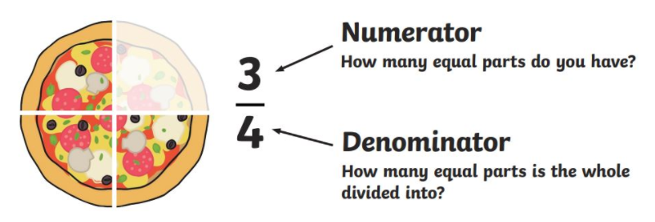
Arithmetic operations
We’ll use variables x, y, z, … a, b, c, … A, B, C, … etc., etc., to denote numbers
Arithmetic operations: +, -, × and ÷
Often we use * to represent × and sometimes we omit the symbol altogether: A × B = A*B = AB
A ÷ B is often written as A/B

Slide 4
Arithmetic operations
We’ll use x, y, z, … a, b, c, … A, B, C, … etc., etc., to denote numbers
Arithmetic operations: +, -, × and ÷
Often we use * to represent × and sometimes we omit the symbol altogether: A × B = A*B = AB
A ÷ B is often written as A/B
When multiple operations are carried out, * and ÷ have precedence over + and –
e.g., 5*4+3 = 23 (not 35) and 8/2+2 = 6 (not 2)

Slide 5
Arithmetic operations and brackets
When we wish to specify a particular order of computation which overrides the normal precedence we use brackets
  e.g., 5*(4+3) = 5*7 = 35
Brackets can also be used to make things absolutely clear even when they are not, strictly speaking, needed
  e.g., (8/2)+2

Slide 6
Distributivity
5*(4+3) = 5*7 = 35, and
5*4 + 5*3 = 20 + 15 = 35
More generally distributivity dictates that:
a(b+c) = ab + ac
Geometrically this is obvious:
a
b
c

Slide 7
Factoring
Sometimes we want to do the opposite in order to pull out a common factor, e.g.,
21 + 35 = 7*3 + 7*5 = 7 * (3 + 5) = 7*8

Slide 8
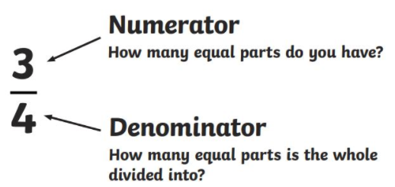
Manipulating fractions
(a/b)*(c/d) = (ac)/(bd)
e.g.,
(3/4)*(5/6) = 15/24
20/28 = (4*5)/(4*7) = (4/4) * (5/7) = 5/7
  i.e., we can cancel the common factor
Notes:
Fraction bar

Slide 9
Manipulating fractions
(a/b)*(c/d) = (ac)/(bd)
e.g.,
(3/4)*(5/6) = 15/24
20/28 = (4*5)/(4*7) = (4/4) * (5/7) = 5/7
  i.e., we can cancel the common factor
1/3 * 3 = 1/3 * 3/1 = 3/3 = 1
  a third of 3 is 1 ; common factors cancel
Notes:
Fraction bar

Slide 10
Manipulating fractions
(a/b)*(c/d) = (ac)/(bd)
e.g.,
(3/4)*(5/6) = 15/24
20/28 = (4*5)/(4*7) = (4/4) * (5/7) = 5/7
  i.e., we can cancel the common factor
1/3 * 3 = 1/3 * 3/1 = 3/3 = 1
  a third of 3 is 1 ; common factors cancel
3/4 * 1/3 =
3/4 * 2/3 =
3 * 4/5 =
Notes:
Fraction bar

Slide 11
Manipulating fractions
(a/b)*(c/d) = (ac)/(bd)
e.g.,
(3/4)*(5/6) = 15/24
20/28 = (4*5)/(4*7) = (4/4) * (5/7) = 5/7
  i.e., we can cancel the common factor
1/3 * 3 = 1/3 * 3/1 = 3/3 = 1
  a third of 3 is 1
3/4 * 1/3 = 3/12 = 1/4
3/4 * 2/3 = 6/12 = ½
3 * 4/5 = 3/1 * 4/5 = 12/5
Notice that in each of these cases we are cancelling common factors
Notes:
Fraction bar

Slide 12
Manipulating fractions
(a/b) ÷ (c/d) = (a/b) * (d/c)
4/5 ÷ 7/8 = 4/5 * 8/7 = 32/35
1/(1/2) = (1/1)/(1/2) = 2/1 = 2
1/(x/y) = (1/1)/(x/y) = (1/1)*(y/x) = y/x

Slide 13
Manipulating fractions
(a/b) ÷ (c/d) = (a/b) * (d/c)
x/y = (x/1)/(y/1) = (x/1)*(1/y) = x*(1/y)
e.g., 4/2 = 4*(1/2)

Slide 14
Manipulating fractions
a/b + c/b = (a+c)/b
This is just distributivity in disguise:
a/b + c/b = a*(1/b) + c*(1/b) = (1/b)*(a+c) = (a+c)/b

Slide 15
Manipulating fractions
a/b + c/b = (a+c)/b
This is just distributivity in disguise:
a/b + c/b = a*(1/b) + c*(1/b) = (1/b)*(a+c) = (a+c)/b
For two general fractions we place them over “a common denominator”:
3/8 + 5/12 = 9/24 + 10/24 = 19/24
Note that a/b + a/c ≠ a/(b+c)

Slide 16
Re-arranging equations
Suppose that a = x + y, and we wish to derive a formula of the form x = … . Switching the order gives x + y = a; subtracting y from both sides gives x + y – y = a – y and hence x = a – y
“solving an equation (for x)”

Slide 17
Re-arranging equations
Suppose that a = x + y, and we wish to derive a formula of the form x = … . Switching the order gives x + y = a; subtracting y from both sides gives x + y – y = a – y and hence x = a – y
If y≠0 and a = x*y then x*y = a; dividing both sides by y gives x*y/y = a/y and therefore (cancelling the common factor y on the left) we have x = a/y
Similarly, if a = x/y then x = a*y

Slide 18
Re-arranging equations
E.g., suppose 5y + 3x = 25, and we wish to express x in terms of y, then:
3x = 25 – 5y, and then
x = (25-5y)/3 = 5(5-y)/3

Slide 19
Re-arranging equations
If a/b = c/d then inverting both sides
b/a = d/c (provided a, c ≠ 0)
E.g., if 3y+1 = 2/(x+1), then
2/(x+1) = 3y+1
(x+1)/2 = 1/(3y+1)
x+1 = 2 * 1/(3y+1) = 2/(3y+1)
x = -1 + 2/(3y+1) = 2/(3y+1) - 1

Slide 20
Powers and Roots

Slide 21
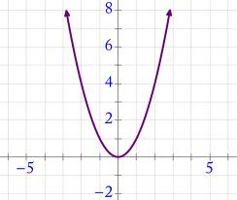
x² = x squared = x*x
x²
x

Slide 22
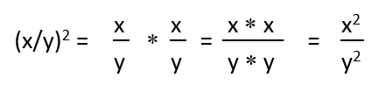
Powers
(xy)² = x ∗ y ∗ x ∗ y = x ∗ x ∗ y ∗ y = x² ∗ y²

Slide 23
The square root
= Inverse of the square
4² = 16 ⇨ √16 = 4; 5² = 25 ⇨ √25 = 5
√x*√x = x … (√x)² = x
x/√x = √x and √x/x = 1/√x
Precedence:
√x + 1 means (√x) + 1; if you want to add first, then use √(x+1) or √x+1
Notes:
Some simplifications of derivations required

Slide 24
The square root
So, for example
√x ( √x + 1) = √x * √x + √x = x + √x
√x (√x + 1/x) = √x * √x + √x*(1/x) =
x + √x/x =
x + 1/√x
3√x + yx = ??
Notes:
Some simplifications of derivations required

Slide 25
The square root
So, for example
√x ( √x + 1) = √x * √x + √x = x + √x
√x (√x + 1/x) = √x * √x + √x*(1/x) =
x + √x/x =
x + 1/√x
3√x + yx = 3√x + y*√x*√x = √x (3 + y√x)
Notes:
Some simplifications of derivations required

Slide 26
The square root
Suppose that 3√x + 5 = 12 . Solve for x!
Notes:
Some simplifications of derivations required

Slide 27
The square root
Suppose that 3√x + 5 = 12 . Solve for x!
3√x = 12 – 5 = 7, and
√x = 7/3, hence
x = 7/3 * 7/3 = 49/9
Notes:
Some simplifications of derivations required

Slide 28
A note on working
Layout your maths methodically and step-by-step: this makes errors less likely and easier to spot; DO NOT use “crossing out”
3√x + 5 = 12
7

Slide 29
Higher Powers
A¹ = A
A² = A * A 4² = 16
A³ = A * A * A 4³ = 64
Etc.
A² * A³ = (A * A) * (A * A * A) = A * A * A * A * A = A⁵
Notes:
Some simplifications of derivations required

